Slide 1
James Webb Space Telescope
Aims
To search for light from the first stars and galaxies
To study the formation and evolution of galaxies
To understand the formation of stars and planetary systems
To study planetary systems and the origins of life

Slide 2
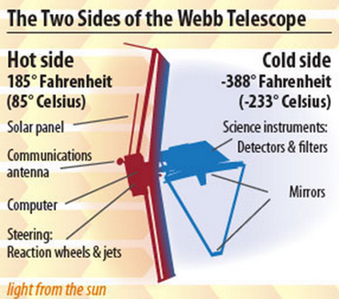
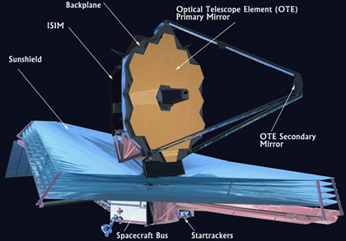
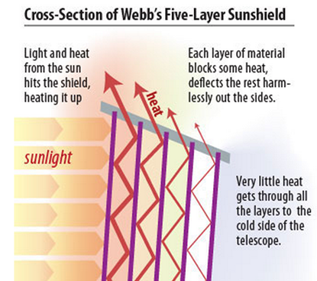
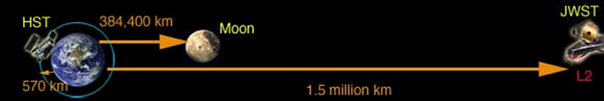
James Webb Space Telescope
James Webb telescope is a large infrared space telescope.
Consists of five main components ;
Near Infrared Spectrograph
Mid Infrared Spectrograph
Near Infrared Camera
“Tennis Court” sized sunshield
Large primary mirror.
Orbit 150 million km from earth at L2 (second Lagrange point).

Slide 3
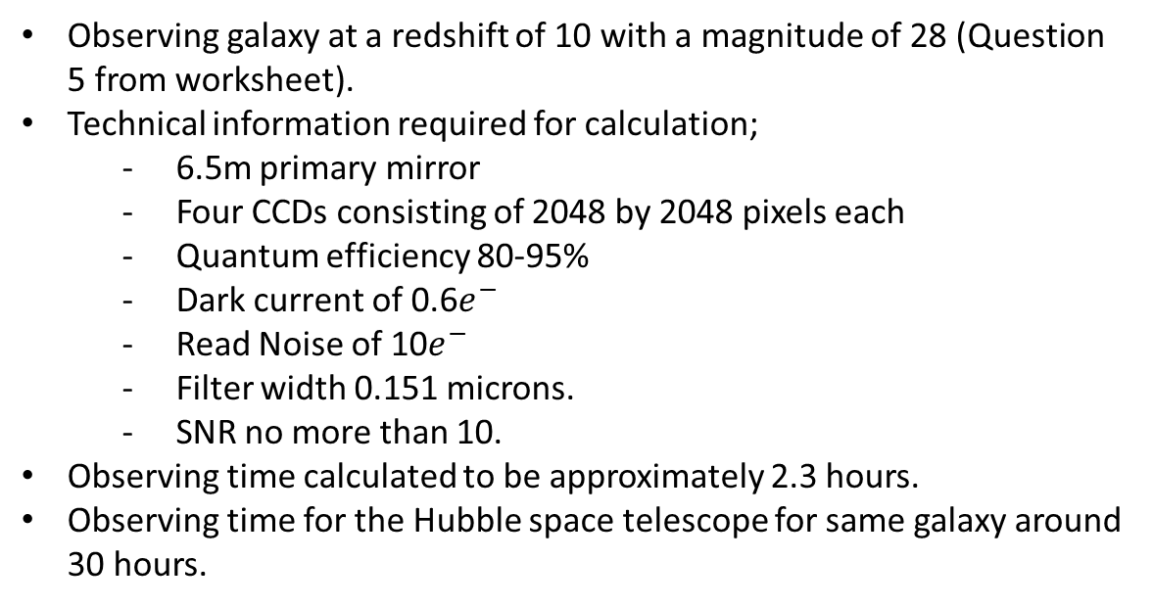
Calculation For Observing Time
Observing galaxy at a redshift of 10 with a magnitude of 28 (Question 5 from worksheet).
Technical information required for calculation;
- 6.5m primary mirror
- Four CCDs consisting of 2048 by 2048 pixels each
- Quantum efficiency 80-95%
- Dark current of 0.6$e^{−}$
- Read Noise of 10$e^{−}$
- Filter width 0.151 microns.
- SNR no more than 10.
Observing time calculated to be approximately 2.3 hours.
Observing time for the Hubble space telescope for same galaxy around 30 hours.

Slide 4


Calculating Observation Time
JWST: t = 2.33 hours

Slide 5

Observation Times
Group Studies - Observing Time Calculations
 | m |  | 28
 | z |  | 10
 | λ(obs) |  | 1.65E-06
 | ν |  | 1.82E+14
 | Energy |  | 1.21E-19
 | Photons per joule |  | 8.30E+18
 | Fν |  | 2.29E-31
 | Fλ |  | 2.52E-24
VLT | Photons |  | 3.04
 | Time (seconds) |  | 2236080.69
 | Time (hours) |  | 621.13
 | Seconds / Exposure |  | 75882.37
 | # of Exposures |  | 29.47
JWST | Filter |  | 0.151
 | Photons |  | 0.84
 | a |  | 0.70
 | b |  | -5877.77
 | c |  | -362113.92
 | Time (seconds) |  | 8402.58
 | Time (Hours) |  | 2.33
 | Seconds / Exposure |  | 8.45E+08
 | # of Exposures |  | 9.95E-06
Hubble | Filter |  | 0.151
 | Photons |  | 0.22
 | a |  | 0.05
 | b |  | -5772.84
 | c |  | -2990719.17
 | Time (seconds) |  | 120020.21
 | Time (Hours) |  | 33.34
 | Seconds / Exposure |  | 2.17E+08
 | # of Exposures |  | 5.54E-04
Background Limited Case
Times
VLT, roughly 620 hours
Hubble, roughly 33 hours
JWST, roughly 2 hours

